Slide 1

Walmart Sales Forecasting
Noah Scanlon

Slide 2
Problem
Walmart has 45 stores, each with many departments, which they need to forecast demand for so to supply each correctly.
Provided are 3 years of historical data with various features.
i.e. holiday (T/F), store-type, temperature, fuel-price, markdowns, etc.
The goal is to predict sales per store, per department, per year, per week

Slide 3
Metric of Success
Mean Absolute Error
This is a regression problem (i.e. predicting $)

Slide 4
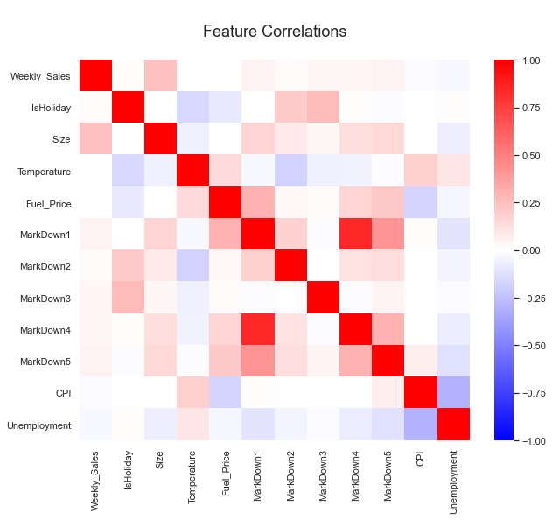
Feature Correlations
Overall, no very notable correlations
We’ll focus on correlations with the target feature next

Slide 5
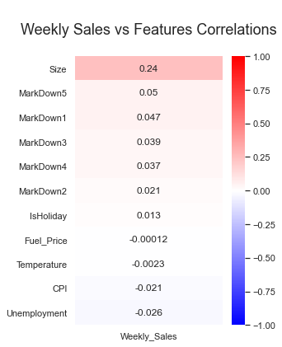
Target vs Other Features’ Correlations
There is no high correlation, positively nor negatively
The highest is only 0.24, between Weekly Sales and [Store] Size

Slide 6
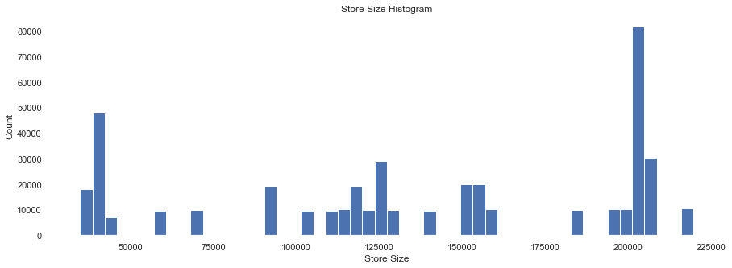
Store Size – Highest Correlator
There’s a good spread of store sizes, with a spike of relatively large and small stores as well

Slide 7
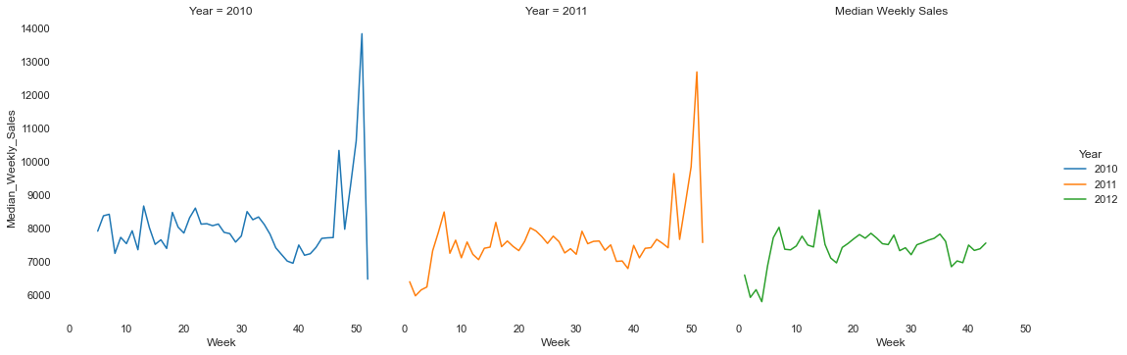
Median Weekly Sales
We can see that there are sales peaks around the U.S. holidays, with relative stability the rest of the year, and that these trends are annual
Mean weekly sales plotted looks nearly identical, but higher

Slide 8
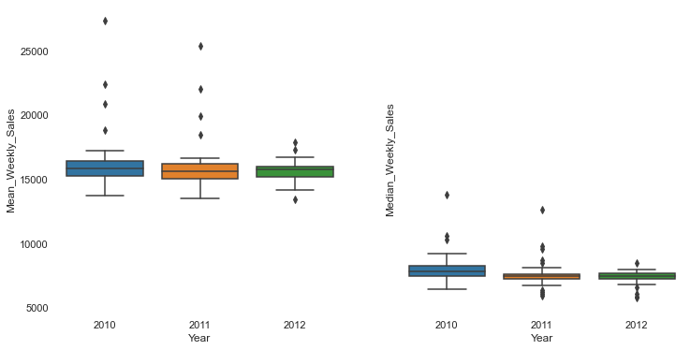
Mean vs Median Weekly Sales
Boxplot Description:
Points – Outliers
Top Whisker – Maximum
Bottom Whisker – Minimum
Box – Interquartile Range
i.e. 0.25, 0.50, 0.75 percentiles
It’s apparent via the difference between the mean and medians that there are values with extremely high values relative to the rest of the dataset

Slide 9
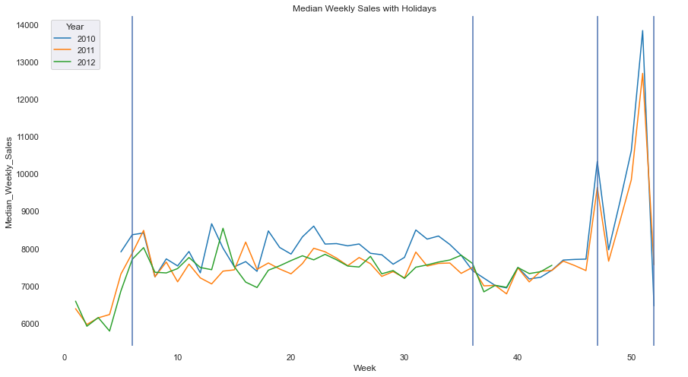
The Holidays
Trends were visibly annual, with spikes around the holidays:
Super Bowl, Labor Day, Thanksgiving, Christmas L→R

Slide 10
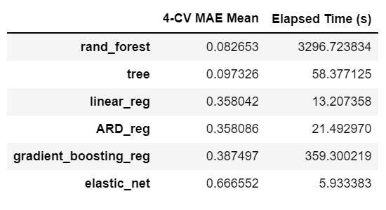
Model Experimentation - Performances
These are untuned model performances
4-CV MAE Mean is the mean absolute error of 4-fold cross-validation
Random-forest achieved the lowest MAE, but only marginally compared to a decision tree.
Especially when considering the difference in training time.

Slide 11
Final Model – Decision Tree Regressor
Max Depth: 119
Min Impurity Decrease: 0.1
Criterion: Friedman MSE
Found via 5-fold RSCV of 100 candidates

Slide 12
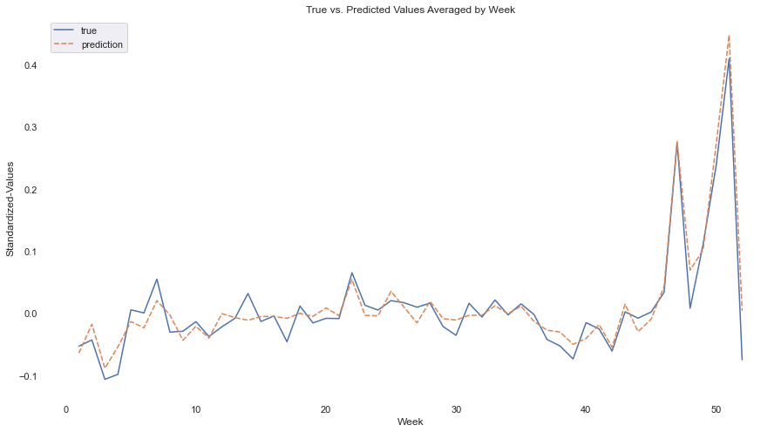
Final Results
MAE: 0.0863

Slide 13
How to Use the Findings
Use this model to forecast and prepare Walmart’s supply operations based on the predictions of demand

